Slide 1
Revenue Analysis Report
2025/02/10

Slide 2
Executive Summary
Why?
The company operates in multiple regions with diverse products, making revenue forecasting crucial for strategic decision-making.
Understanding key revenue drivers (Cost, Units Sold, and Customer Satisfaction) allows for optimizing pricing, inventory, and sales strategies.
Predicting revenue for the next three months provides insights into potential risks and growth opportunities, enabling proactive decision-making.
What?
Revenue Trends: Revenue is primarily driven by Units Sold, with Cost playing a moderate role, while Customer Satisfaction has a weak direct impact.
Regional & Product Performance: Certain regions and products consistently outperform, highlighting areas for potential investment.
Forecasting Results: A regression model using past revenue (t−1) predicts stable growth but reveals risks related to market fluctuations and operational inefficiencies.
Risks & Opportunities: Over-reliance on high-performing regions/products poses a risk, but leveraging data-driven pricing and expansion strategies offers growth potential
Optimize Sales & Inventory – Focus on high-performing regions and adjust stock levels accordingly.
Refine Pricing & Marketing – Implement dynamic pricing and targeted campaigns for underperforming products.
Enhance Forecasting Models – Integrate external factors like market trends for improved accuracy.
Expand & Strengthen Customer Engagement – Identify new market opportunities and improve retention strategies.
Next Steps

Slide 3
Analysis Overview

Slide 4
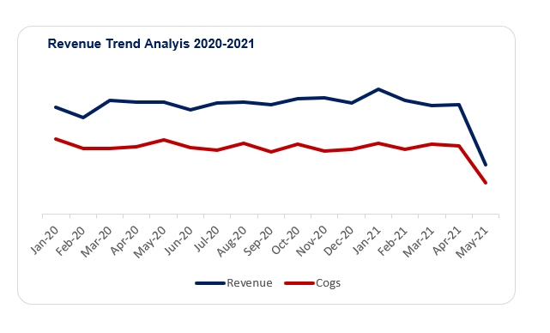
Analysis Overview
Key Highlights
Revenue Drivers: Units Sold is the strongest revenue contributor, followed by Cost, while Customer Satisfaction has minimal direct impact.
Regional & Product Performance: Certain regions/products dominate revenue, presenting expansion and optimization opportunities.
Forecasted Growth: Revenue projections for the next three months indicate stable performance with potential seasonal fluctuations.
Risks & Opportunities: Over-reliance on key markets/products poses risks, but targeted pricing and sales strategies can drive growth.
Strategic Focus: Immediate actions on sales optimization, pricing adjustments, and improved forecasting will maximize revenue potential.

Slide 5
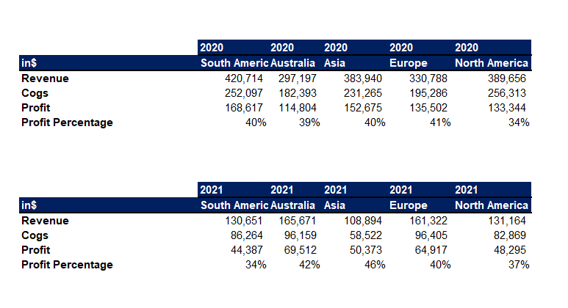
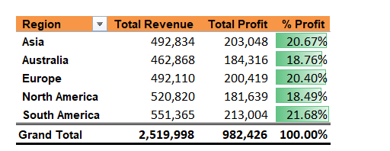
Revenue by Region
Performance bu Region
Our revenue distribution across regions reveals critical insights into where we are excelling and where we have opportunities for growth. This data-driven approach allows us to allocate resources effectively and optimize our revenue strategy.
Overarching Competitive Advantage: By harnessing data-driven insights, optimizing our strongest revenue markets, and strategically expanding into underperforming regions, we create a sustainable competitive advantage that drives revenue growth while mitigating risk.
South America is our highest revenue-generating region, followed by North America and Asia.
These markets are driving a significant portion of total revenue, indicating strong sales volumes and customer demand.

Slide 6
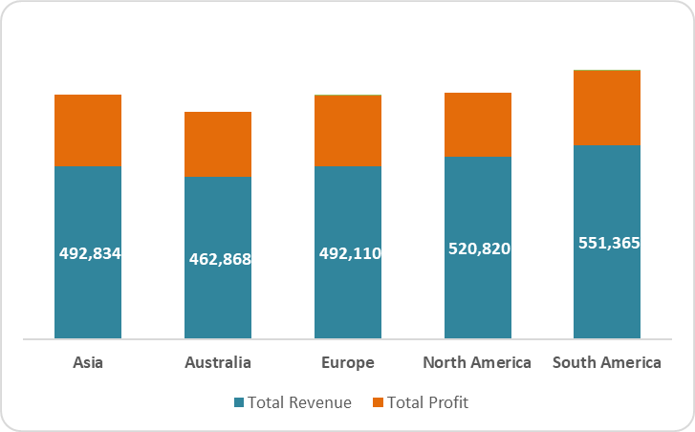
Sales Distribution
Key insights
Sales volume varies significantly across regions, impacting overall revenue distribution.
Top-performing regions (South America, North America, and Asia) drive the majority of sales, aligning with revenue trends.
Europe and Australia show moderate sales figures, suggesting opportunities for growth.
Sales-to-revenue ratio differs by region, indicating variations in pricing strategy, product mix, and operational efficiency.

Slide 7
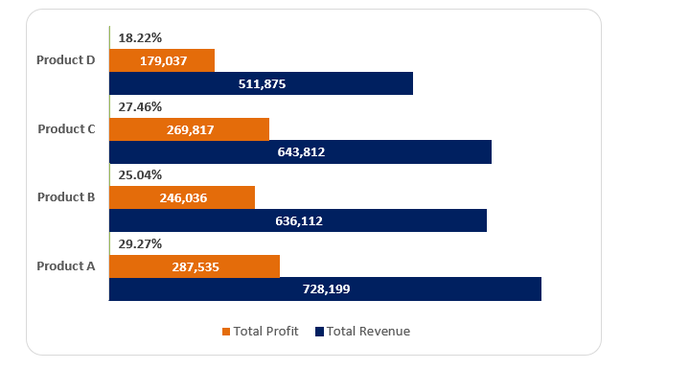
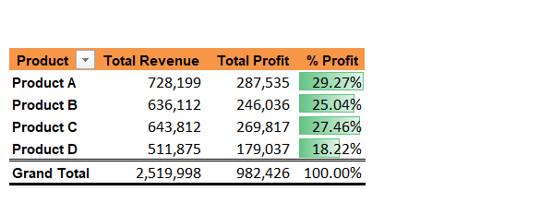
Product Line Analysis
Optimizing Product Performance for Sustainable Revenue Growth
Price Volume Mix
Maximize high-revenue products through strategic pricing, marketing, and innovation.
Optimize mid-tier products by improving margins, bundling, and targeted promotions.
Revitalize or phase out low-performing products based on market demand and profitability analysis.

Slide 8
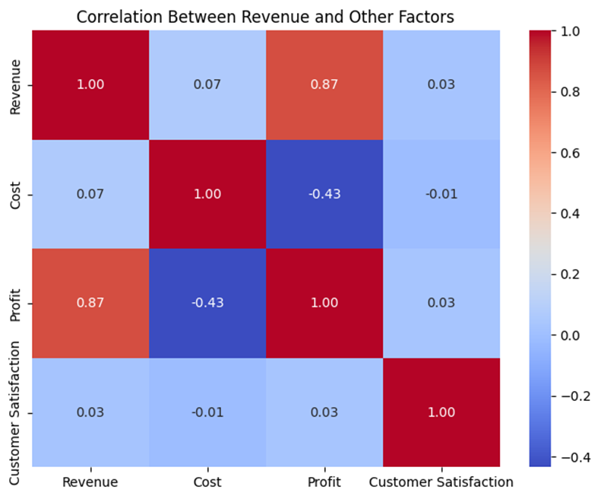
Key Trends
Financial Metrics & Implications
Company Revenue
Revenue Breakdown
Total Revenue: 2.52M
Average Daily Revenue: 5,040
Max Daily Revenue: 8,950
Min Daily Revenue: 950
Key Company Metrics
Industry
Top Products: Product A generated the most revenue, followed by Product C and Product B. Profitability Trends: While revenue is high in certain regions and products, profit margins vary significantly.
Revenue Profile
Industry Outlook: The outlook is moderate growth with predictable variations, meaning that strategic adjustments in pricing, marketing, and product mix could optimize revenue further.
Weak Customer Satisfaction Impact: With a correlation of 0.029, customer satisfaction does not appear to be a primary driver of revenue, suggesting that factors such as pricing, market size, and regional presence play a larger role.

Slide 9
Regression Overview

Slide 10
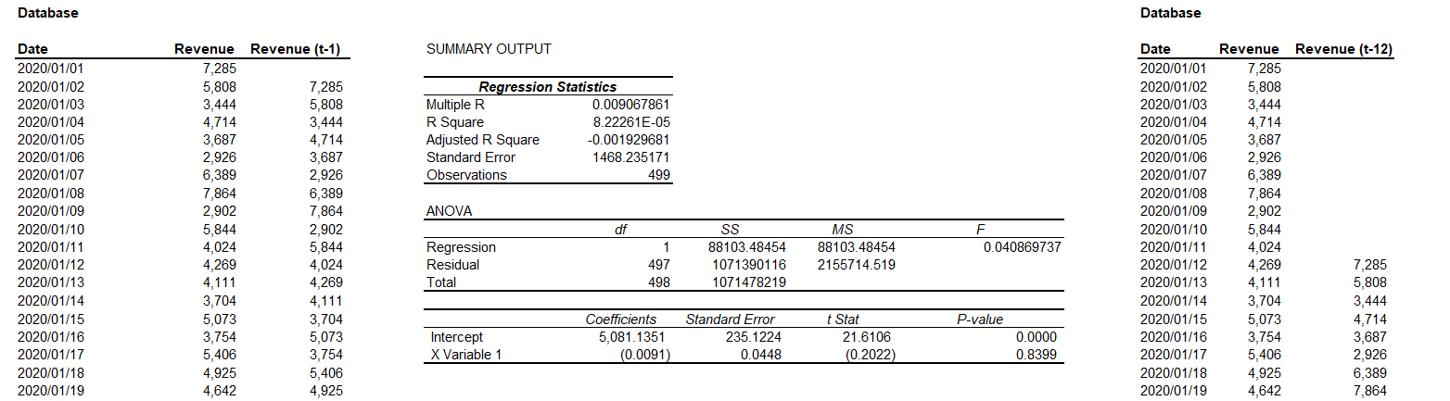
Regression Analysis
Revenue Forecasting Using Regression on (t−1)
Historical revenue trends indicate strong correlation with past performance, justifying the use of t−1 as a predictor.
The model provides a straightforward yet effective short-term forecasting method, balancing accuracy and interpretability.
Regression results show stable revenue growth, with minor variations due to external factors not captured in t−1 alone.
Strategic application allows for proactive planning in inventory, budgeting, and resource allocation.
Future model enhancements could incorporate external variables (e.g., market trends, inflation) for improved long-term accuracy.

Slide 11
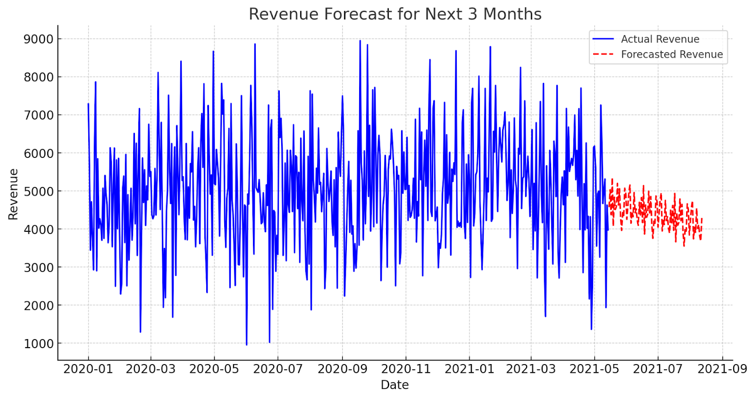
Regression Analysis
Key Insights:
Market Dynamics:
Competitors are leveraging pricing strategies, digital transformation, and customer engagement to gain market share.
Competitive Positioning:
Our strongest advantages lie in data-driven forecasting, regional dominance, and product performance optimization.
Key competitors are focusing on cost leadership, product diversification, or aggressive expansion strategies.
Threats & Challenges:
Price competition could impact margins if cost efficiency is not optimized.
Market saturation in key regions may limit organic growth, requiring new market penetration strategies.
Macroeconomic risks (inflation, supply chain disruptions) could affect revenue stability.
Opportunities for Competitive Edge:
Data-driven decision-making to enhance pricing, inventory, and regional strategies.
Customer-centric innovation to differentiate products and increase brand loyalty.
Expansion into high-growth markets by leveraging insights from revenue trends and demand forecasting.

Slide 12
Recommendations

Slide 13
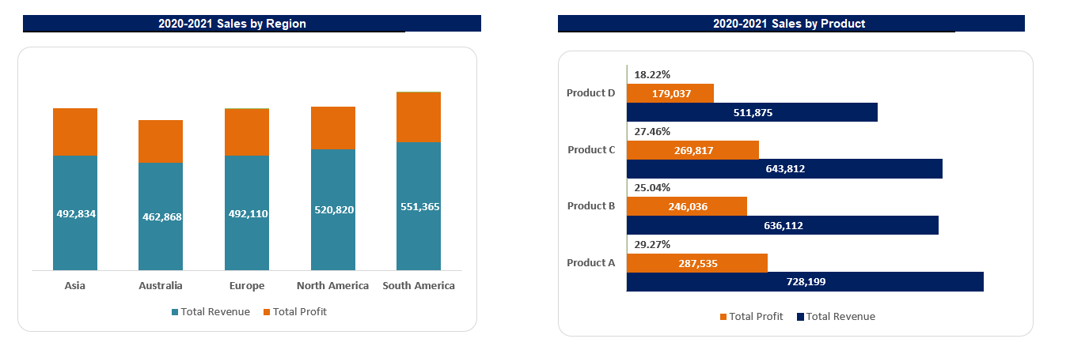
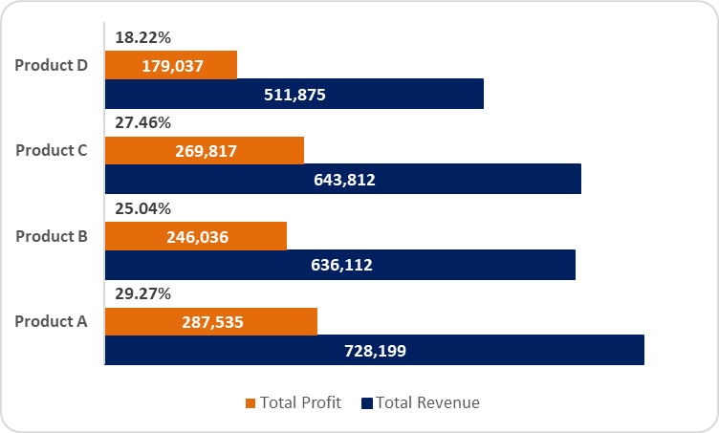
Recommendation
Insights
Target Revenue.
Expand High-Performing Regions: Invest in marketing, optimize distribution, and introduce premium pricing in top revenue-generating regions.
Revitalize Low-Performing Regions: Launch targeted promotions, expand local partnerships, and adjust pricing based on demand elasticity.
Optimize High-Revenue Products: Bundle products, introduce premium versions, and leverage upselling strategies to maximize revenue per customer.
Reposition Low-Revenue Products: Conduct market research, rebrand or discontinue underperforming items, and test new product variations.
Leverage Digital & Sales Strategies: Implement dynamic pricing, enhance e-commerce presence, and train sales teams to convert more leads efficiently.
Strategic Rationale
Product Revenue
Maximizing High-Performing Segments: Expanding successful regions and products ensures faster revenue growth with minimal risk, leveraging existing demand.
Unlocking Untapped Potential: Addressing low-performing regions and products allows for market expansion, diversifying revenue streams and reducing dependency on top segments.
Enhancing Profitability: Optimizing pricing, bundling, and premium product strategies increases revenue per unit sold while improving profit margins.
Adapting to Market Dynamics: Dynamic pricing and localized strategies enable responsiveness to consumer demand, competition, and economic shifts.

Slide 14
Strategic Review and Opportunities
Opportunities for Revenue Growth
Reco 1:
Market Expansion in Underperforming Regions
Enter new geographic markets with high demand potential.
Customize product offerings based on regional preferences.
Strategic Review (Current State)
Revenue Distribution: Revenue is concentrated in specific regions and products, meaning the company depends on a few key markets.
Profitability Variation: Some high-revenue segments have low profit margins, indicating potential inefficiencies in pricing or cost management.
Customer Satisfaction Impact: With a weak correlation to revenue, current business strategy does not seem heavily reliant on improving customer experience .
Seasonal Trends Observed: Revenue follows a periodic pattern, suggesting external factors (holidays, economic cycles) influence sales performance.
Reco 2:
Product Diversification & Upselling
Introduce premium versions of high-performing products.
Bundle products together to increase total revenue per transaction.
Operational Efficiency & Cost Management
Improve supply chain to reduce costs and boost profit margins.
Optimize pricing strategy based on customer demand elasticity
Reco 3:

